Slide 1

Welcome to this Lecture:
Getting Started with Python
The session will start shortly…
Questions? Drop them in the chat.
We'll have dedicated moderators answering questions.

Slide 2


Getting Started with Python
March 2024
Notes:
Welcome to the Grammar Skills Bootcamp Orientation for November 2023. Today, we will cover several important aspects of this program to ensure you have all the information needed for a successful learning experience.

Slide 3

Agenda
The Terminal
Setting Up Dev Environments
Data Types
Conditional Statements
Notes:
Mention moderators and Questions tab. Our agenda includes an introduction to CoGrammar, details about student success support, graduation criteria, guided learning hours, learning tools and platforms, an overview of the Skills Bootcamp, and career services.

Slide 4
The Terminal

Slide 5
What is a Terminal ?
The terminal, also known as the command line or shell, is a text-based interface used for interacting with your computer's operating system. Instead of relying on graphical elements like buttons and icons, you communicate with the computer by typing commands. It allows you to perform various tasks such as navigating the file system, executing programs, and managing files efficiently.
Notes:
Mention moderators and Questions tab. Our agenda includes an introduction to CoGrammar, details about student success support, graduation criteria, guided learning hours, learning tools and platforms, an overview of the Skills Bootcamp, and career services.

Slide 6
Basic Commands
pwd - Print the current working directory.
ls - List the contents of the current directory.
cd <directory> - Change directory to the specified directory.
mkdir <directory> - Create a new directory.
touch <file> - Create a new file.
rm <file> - Remove a file.
cp <source> <destination> - Copy a file or directory.
mv <source> <destination> - Move or rename a file or directory.
Notes:
Mention moderators and Questions tab. Our agenda includes an introduction to CoGrammar, details about student success support, graduation criteria, guided learning hours, learning tools and platforms, an overview of the Skills Bootcamp, and career services.

Slide 7
Command Line Tips
Windows
Mac
Utilise commands like `cd` and `dir` in the Command Prompt for navigation and listing directory contents.
Windows-specific shortcuts like `Ctrl+C` for copy and `Ctrl+V` for paste can be used in the Command Prompt.
Consider using PowerShell for more advanced command-line tasks and automation on Windows systems.
Use `cd` to change directories and `ls` to list directory contents in the Terminal.
Mac-specific shortcuts like `Cmd+C` for copy and `Cmd+V` for paste work in the Terminal as well.
Customise your Terminal appearance and behavior through Terminal preferences.

Slide 8
Setting up your
Dev Environments

Slide 9
Establishing a development environment is crucial for software development as it involves installing essential tools, libraries, and dependencies to effectively write, test, and debug code.
Installation:
Visit the official website and download the installer for your operating system: VsCode Download Link Website
Install VSCode:
Run the installer and follow the on-screen instructions to install VSCode on your system.
Settings:
Customize VSCode settings by going to File > Preferences > Settings (or by pressing Ctrl+,). You can configure editor settings, themes, and extensions preferences here.
Notes:
CoGrammar is a leading provider of coding Skills Bootcamps and online courses. Our partnership with HyperionDev brings the latest tech stack expertise and industry insights. Our hands-on, project-based approach is designed to be challenging yet accessible.

Slide 10
Data Types

Slide 11
What are Data Types ?
In Python, like in many programming languages, data types define the kind of data that can be stored and manipulated in a program. Understanding data types is fundamental because it allows you to work with different kinds of information effectively.
Notes:
Mention moderators and Questions tab. Our agenda includes an introduction to CoGrammar, details about student success support, graduation criteria, guided learning hours, learning tools and platforms, an overview of the Skills Bootcamp, and career services.

Slide 12
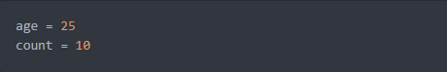
Here are some of the basic data types in Python:
Integer (`int`):
An integer represents whole numbers without any decimal points. It can be positive, negative, or zero. Integers are used to represent quantities that can be counted or measured in whole units.
Example:
Notes:
CoGrammar is a leading provider of coding Skills Bootcamps and online courses. Our partnership with HyperionDev brings the latest tech stack expertise and industry insights. Our hands-on, project-based approach is designed to be challenging yet accessible.

Slide 13
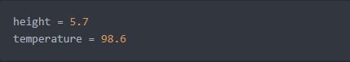
Data types continued…
Float (`float`):
A float represents numbers with decimal points. Floats are used to represent quantities that can have fractional parts, such as measurements, percentages, or values resulting from mathematical calculations.
example:
Notes:
CoGrammar is a leading provider of coding Skills Bootcamps and online courses. Our partnership with HyperionDev brings the latest tech stack expertise and industry insights. Our hands-on, project-based approach is designed to be challenging yet accessible.

Slide 14
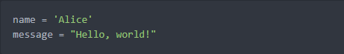
Data types continued…
String (`str`):
A string represents a sequence of characters, such as letters, numbers, or symbols, enclosed within single quotes ('') or double quotes (""). Strings are used to represent text data in Python.
example:
Notes:
CoGrammar is a leading provider of coding Skills Bootcamps and online courses. Our partnership with HyperionDev brings the latest tech stack expertise and industry insights. Our hands-on, project-based approach is designed to be challenging yet accessible.

Slide 15
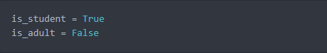
Data types continued…
Boolean (`bool`):
A boolean represents one of two values: `True` or `False`. Booleans are used in logical operations and conditional statements to make decisions based on whether a condition is true or false.
example:
Notes:
CoGrammar is a leading provider of coding Skills Bootcamps and online courses. Our partnership with HyperionDev brings the latest tech stack expertise and industry insights. Our hands-on, project-based approach is designed to be challenging yet accessible.

Slide 16
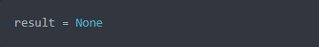
Data types continued…
NoneType (`None`):
NoneType represents the absence of a value or a null value. It is used to indicate that a variable does not have a value assigned to it.
example:
Notes:
CoGrammar is a leading provider of coding Skills Bootcamps and online courses. Our partnership with HyperionDev brings the latest tech stack expertise and industry insights. Our hands-on, project-based approach is designed to be challenging yet accessible.

Slide 17
Let's take a
break

Slide 18
Conditional Statements
Conditional statements are like decision-making tools in programming. They help you decide what to do in different situations based on specific conditions. Depending on whether a condition is true or false, you can choose to run different parts of your code. It's a way to make your program smarter and more flexible, allowing it to adapt to different scenarios as needed.
Notes:
Mention moderators and Questions tab. Our agenda includes an introduction to CoGrammar, details about student success support, graduation criteria, guided learning hours, learning tools and platforms, an overview of the Skills Bootcamp, and career services.

Slide 19
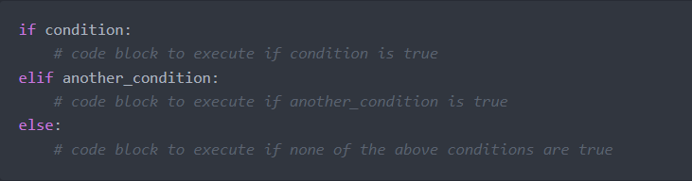
Types of Conditional Statements
Conditional statements help your program make decisions and adapt its behavior accordingly. There are primarily three types of conditional statements in programming:
Notes:
CoGrammar is a leading provider of coding Skills Bootcamps and online courses. Our partnership with HyperionDev brings the latest tech stack expertise and industry insights. Our hands-on, project-based approach is designed to be challenging yet accessible.

Slide 20
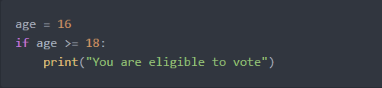
Conditional Statements cont.
if statement:
It executes a block of code if a specified condition is true.
Notes:
Mention moderators and Questions tab. Our agenda includes an introduction to CoGrammar, details about student success support, graduation criteria, guided learning hours, learning tools and platforms, an overview of the Skills Bootcamp, and career services.

Slide 21
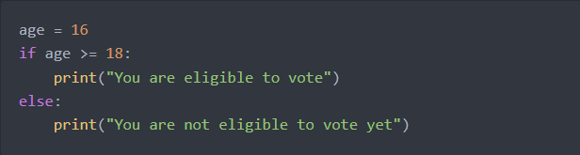
Conditional Statements cont.
if-else statement:
It executes one block of code if the condition is true and another block if the condition is false.
Notes:
Mention moderators and Questions tab. Our agenda includes an introduction to CoGrammar, details about student success support, graduation criteria, guided learning hours, learning tools and platforms, an overview of the Skills Bootcamp, and career services.

Slide 22
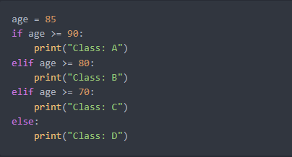
Conditional Statements cont.
if-elif-else statement:
It allows you to check multiple conditions and execute different blocks of code depending on which condition is true.
Notes:
Mention moderators and Questions tab. Our agenda includes an introduction to CoGrammar, details about student success support, graduation criteria, guided learning hours, learning tools and platforms, an overview of the Skills Bootcamp, and career services.

Slide 23
Questions and
Answers

Slide 24

Thank you for attending

